Slide 1
ITSA 教育部程式自學平台
https://e-tutor.itsa.org.tw/e-Tutor/

Slide 2
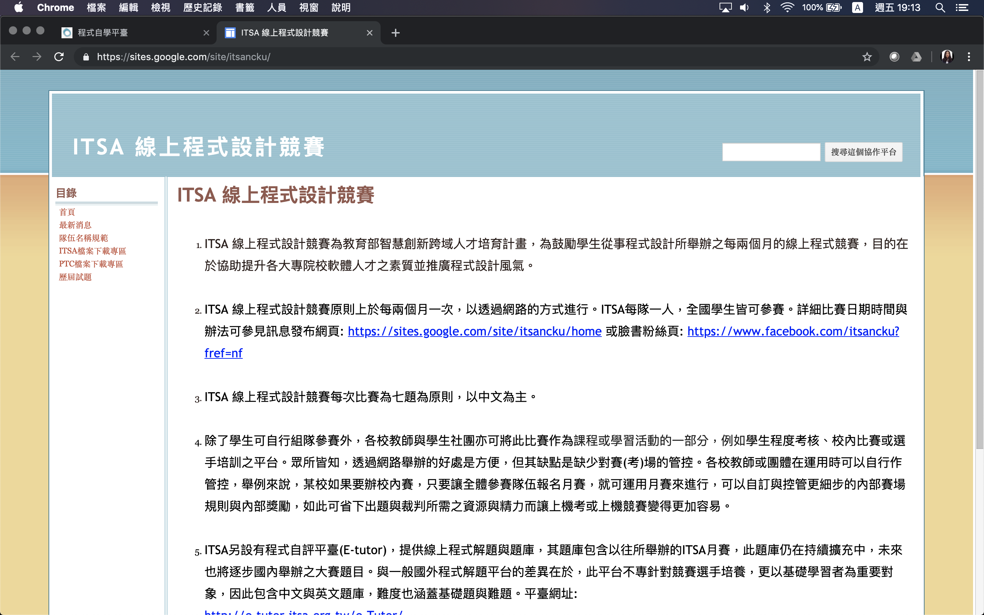

Slide 3
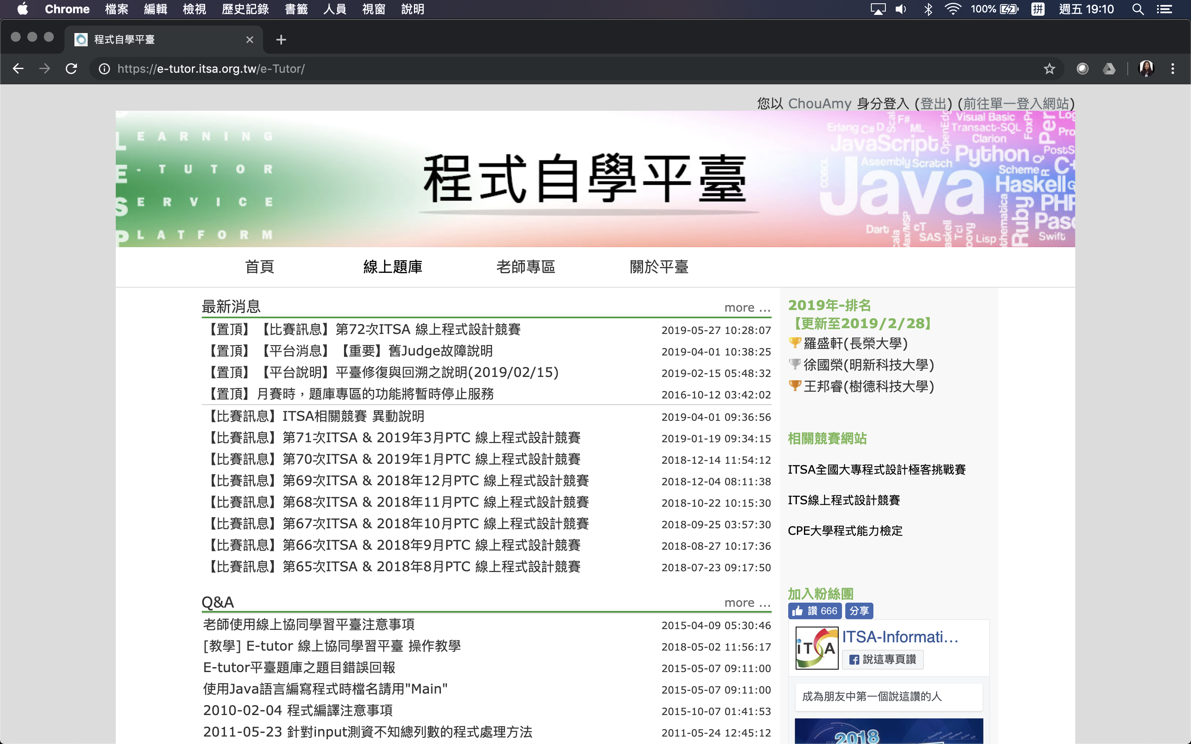

Slide 4
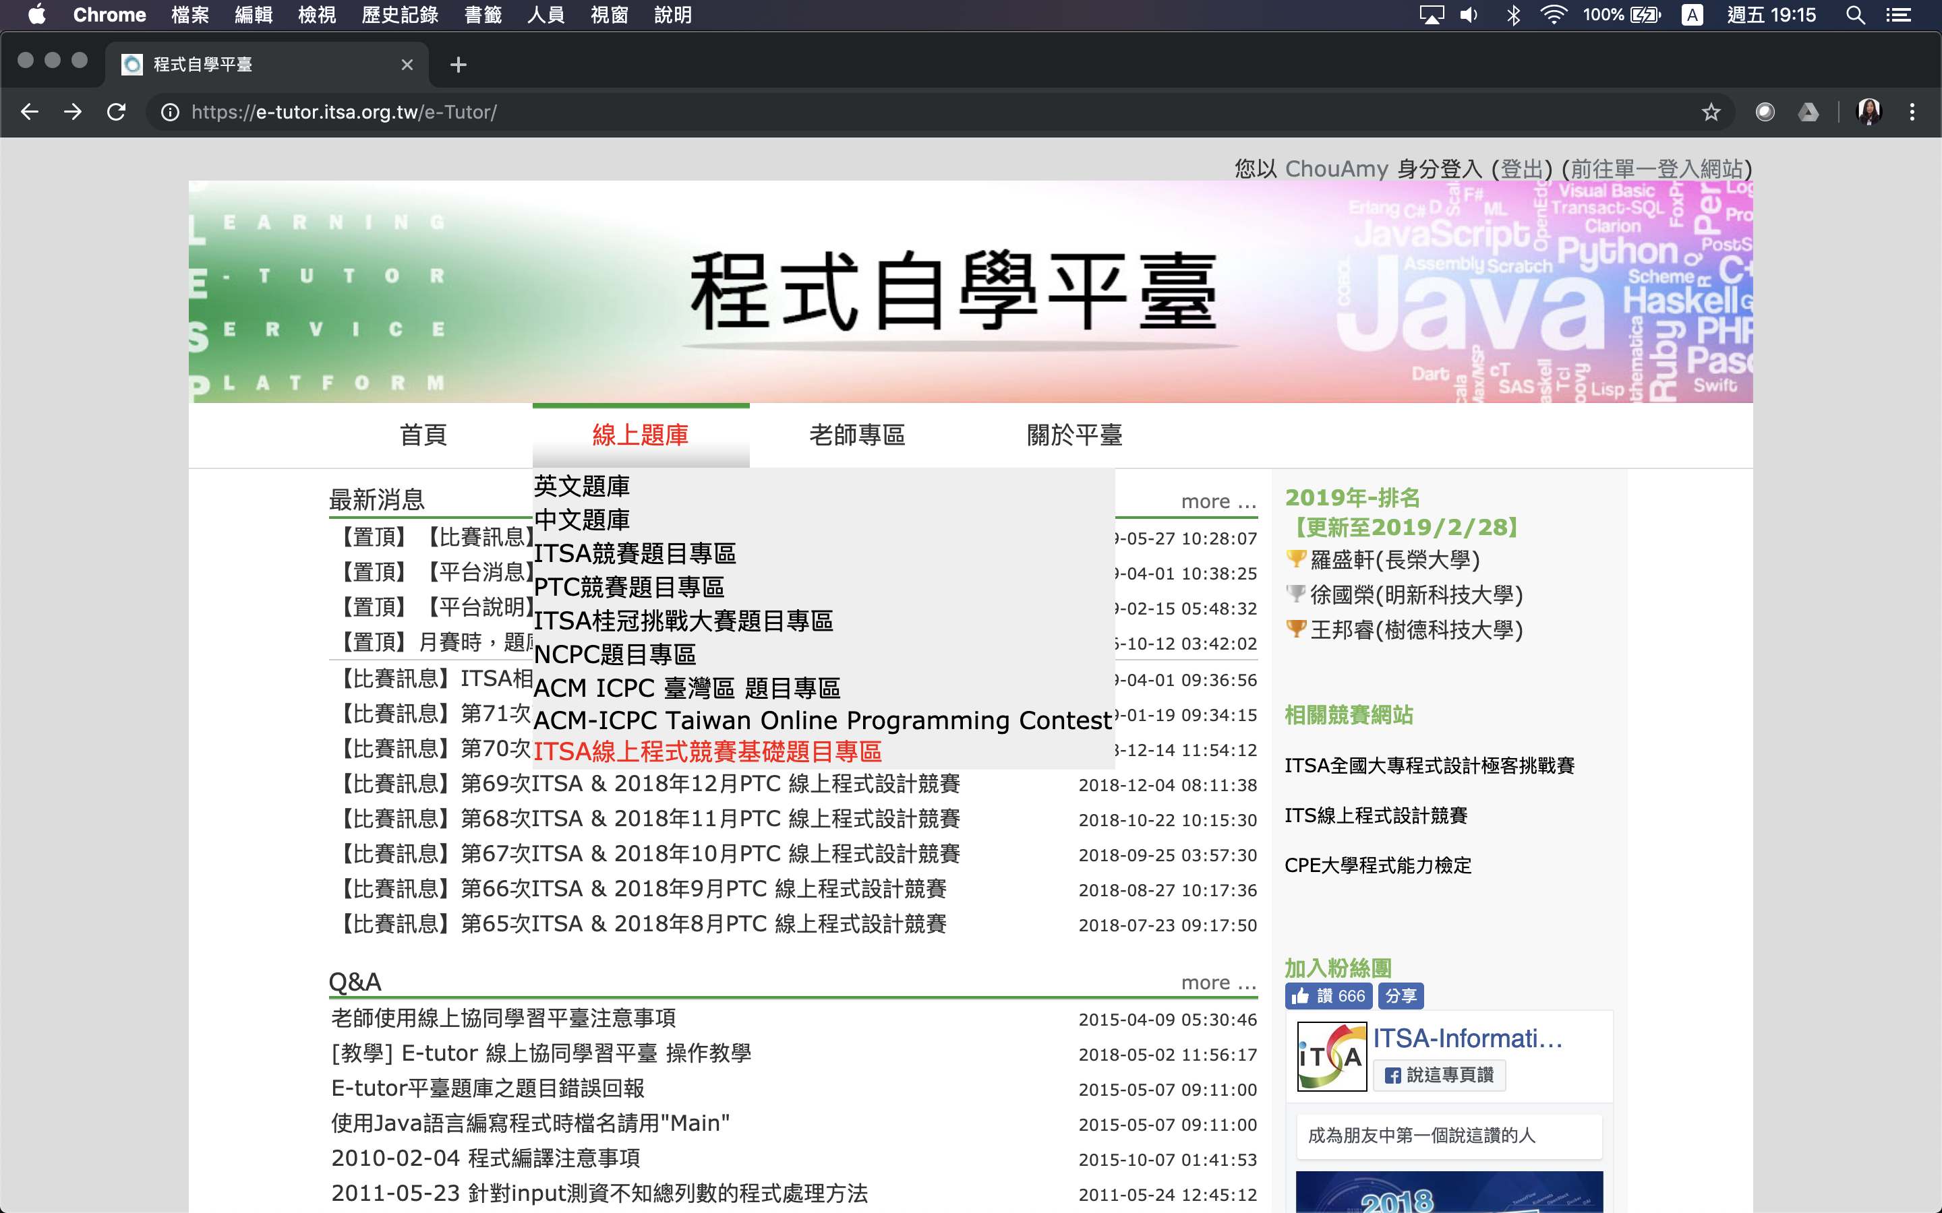

Slide 5
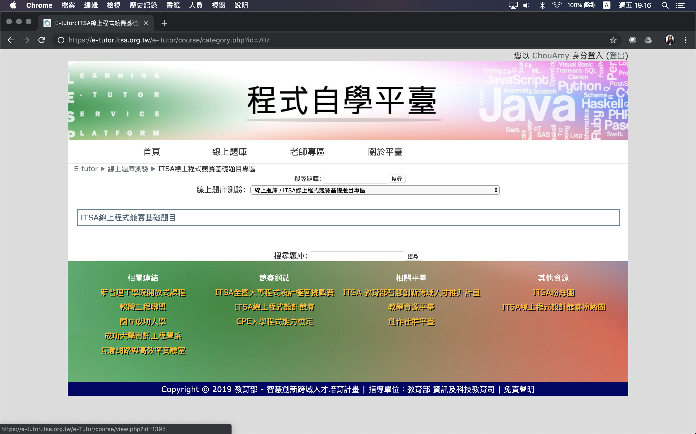

Slide 6
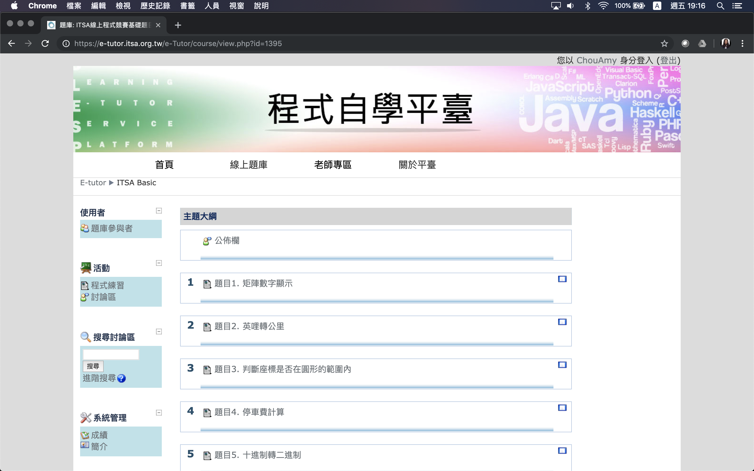

Slide 7
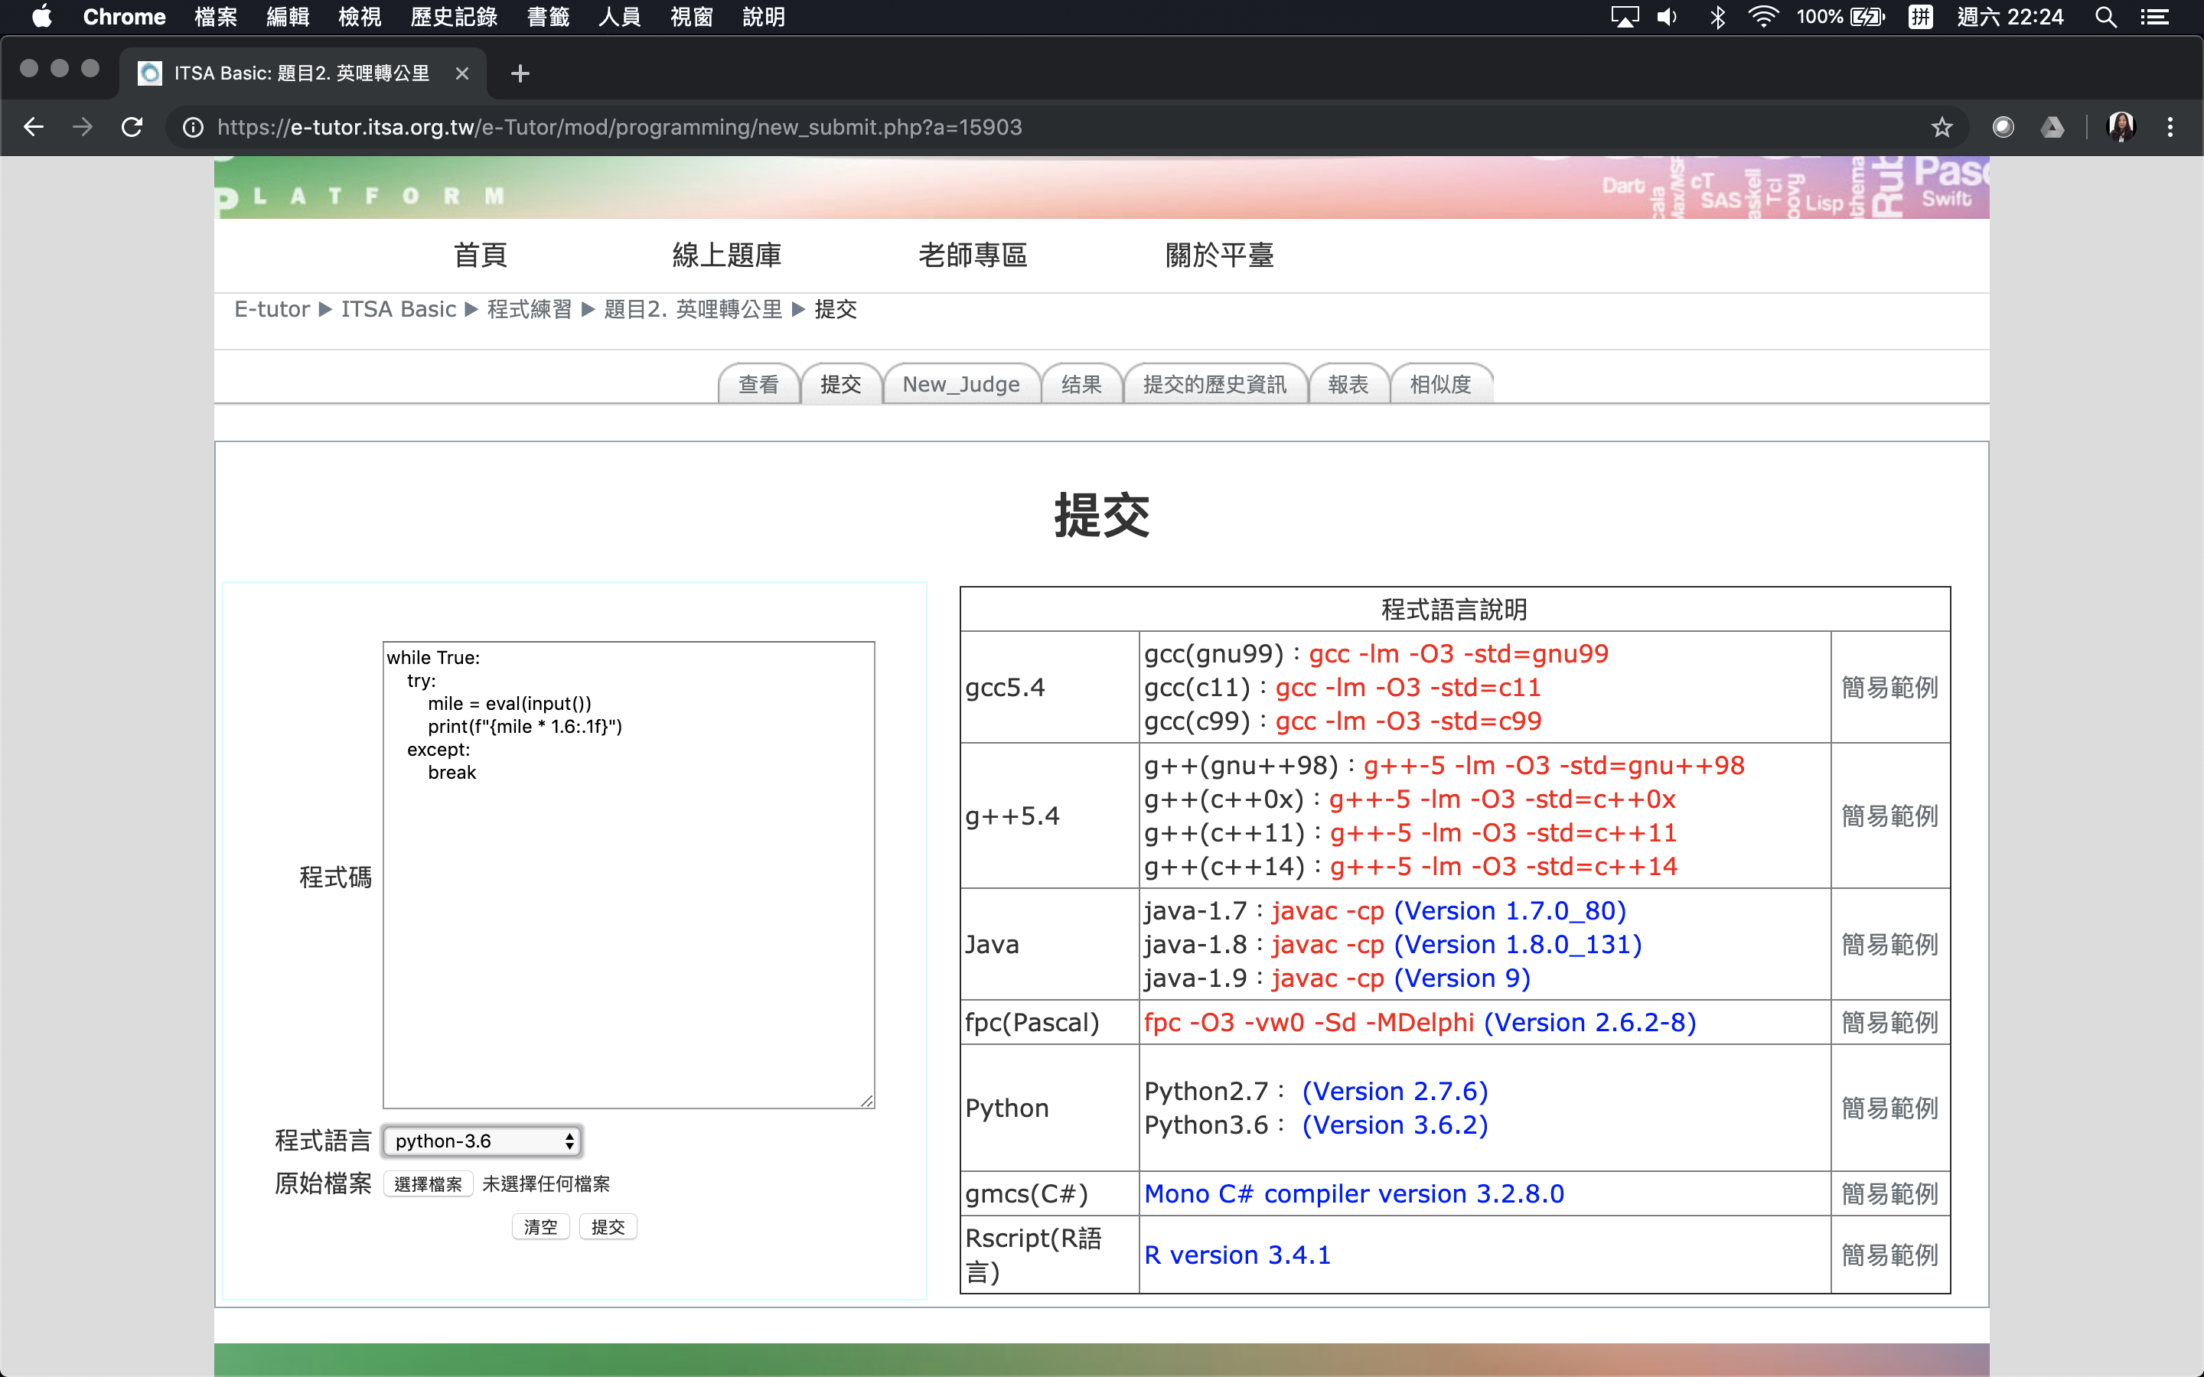
6
1
5
2
3
4

Slide 8
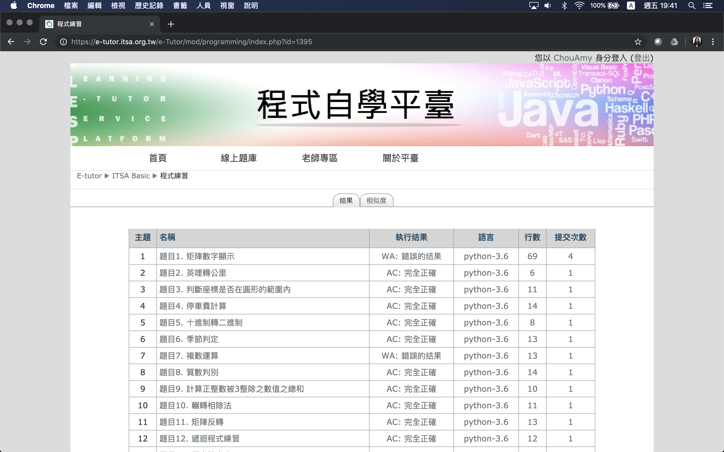

Slide 9
提交程式時, 接收測資的方式

Slide 10
輸入測資: 一個數字
﻿while True:
try:
N = eval(input())
=== your code here ===
cnt = 0
for n in range(1, N+1):
if n % 3 == 0:
cnt += n
print(cnt)
except:
break

Slide 11
輸入測資: 兩個整數
﻿while True:
try:
N1, N2 = map(int, input().split())
=== your code here ===
if N1 < N2:
N1, N2 = N2, N1
while N1 % N2 > 0:
N1, N2 = N2, N1 % N2
print(N2)
except:
break

Slide 12
輸入測資: 一串用空白分隔的整數
while True:
try:
n = int(input())
for i in range(n):
scores = list(map(int, input().split()))
=== your code here ===
except:
break

